Slide 1
How to help with Spelling: some simple tips…
From the Tower Hamlets Language Literacy and Communication Team

Slide 2
Why can spelling be so hard for those with dyslexia?
Spelling can be particularly challenging for people with dyslexia because they can have difficulty with:
Using sounds (phonics)
Sequencing letters
Remembering things
Processing quickly and fluently
Motor-coordination
Notes:
Spelling can be challenging for many people. There are different ways of writing the same sound, not all words are written as they sound and there can be lots of rules and exceptions (e.g. ‘I’ before ‘e’ except after ‘c’) which are not always easy to learn.
However, spelling can be particularly difficult for students with dyslexia due to their difficulty in using sounds, sequencing letters, remembering things like a sequence of letters, processing quickly and fluently. They can also have motor-co-ordination difficulties which can affect their ability to write the words clearly and legibly.

Slide 3
Notes:
So how can we encourage pupils who struggle to learn how to spell a word? Generally it is good to a use a multisensory approach which is fun. This approach, called Simultaneous Oral Spelling involves tracing, copying, writing the word without looking and finally a final best copy. The pupil needs a piece of paper folded into four sections. The word being learnt needs to be written into Box 1. In this example, the tricky word ‘said’ has been used. You could use any word, e.g. a topic word.
Box 1-Pupil traces over the word, saying the letter names as they write. This is important. Some pupils need to be encouraged to say the letters clearly to themselves.
Box 2- Pupil copies the word, again, saying the letter names as they write.
Box 3- The fun bit! Pupil write the word with their eyes shut saying the letter names. Encourage the pupil to visualise the word, which can often be difficult with pupils who have spelling difficulties. Be explicit about ‘seeing the word in your head’. When finished, they check it with box one. If they have made a mistake, they can go back and repeat the tracing and copying activity from Boxes 1 and 2.
Box 4- Pupil covers Boxes 1,2 and 3 and writes word independently then checks their word letter by letter with the word in Box 1. If they have made a mistake, encourage them to spot which letters they got correct and which letters they need to change. This helps to develop their metacognition, so they can begin to identify for themselves what they need to do next. If necessary repeat the stages.

Slide 4
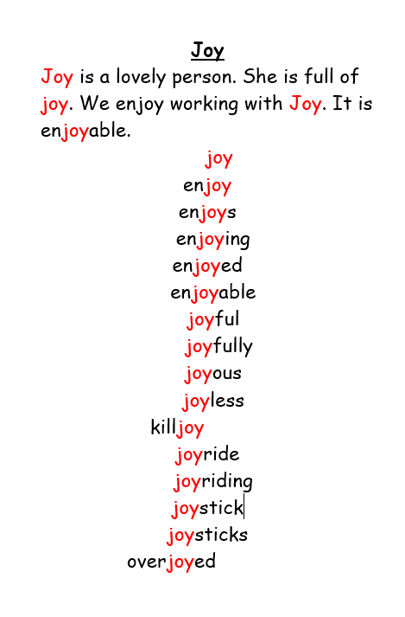
Using Morphology
Notes:
Using morphology can help dyslexic learners to learn spellings. Morphemes are the smallest meaningful units of meaning. It is less scary to learn a list of words when the root word has meaning. In this example, 15 words have been made using the word ‘joy’. So the pupil only has to focus on remembering the beginning and the ending of the words. It can be very helpful to use highlighter pens for this.
It is good for pupils to become aware of syllables. E.g., the word ‘joy’ has one syllable. I only clap once when I say the word ‘joy’.
The word ‘joy-ride’ has two syllables. I clap twice when I say it.
‘En-joy-ing’ has three syllables. I can clap three times.
‘En-joy-a-ble’ has four syllables. I can clap four times.

Slide 5
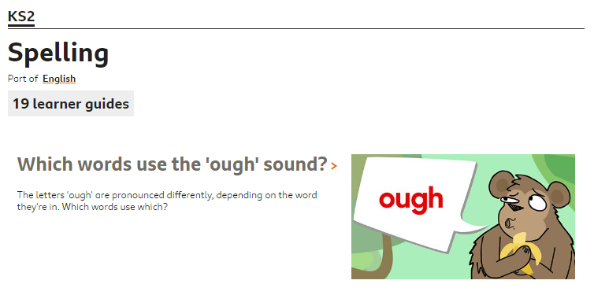
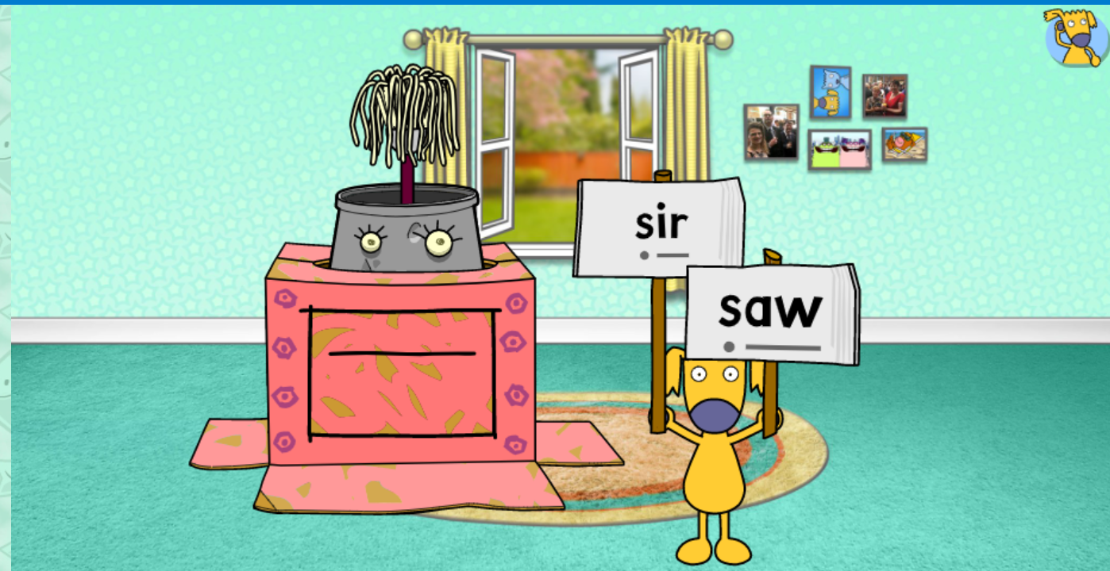
Some websites for practising spelling patterns….
BBC Bitesize: https://www.bbc.co.uk/bitesize/topics/zt62mnb
https://www.busythings.co.uk/play/
Notes:
Find out what sites your school already has a subscription with.
BBC Bitesize:
https://www.bbc.co.uk/bitesize/topics/zt62mnb
Lots of free games here
Busy Things is free with LGfL login
https://www.busythings.co.uk/play/

