Slide 1
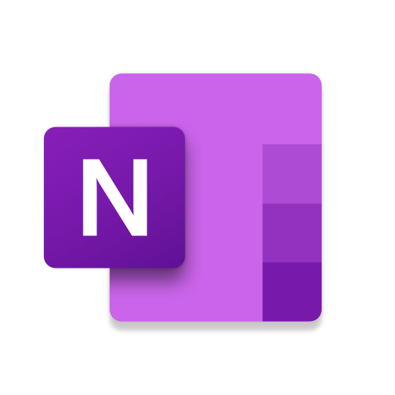
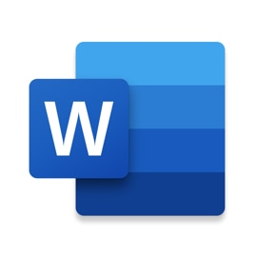
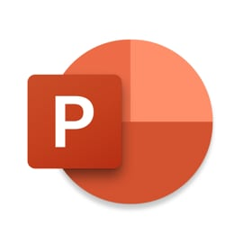
Tower Hamlets Learning Advisory Service
Microsoft 365 and Immersive Reader
Immersive Reader is a powerful, and free, reading support tool that is built into Microsoft applications.
Notes:
The Office 365 suite has been offered to schools free-of-charge for some time now. You may have access to it already, but if not ask you technician!
Students and educators can download Office 365 Education for free. All you need is a valid school email address.
Office comes bundled with some powerful literacy support tools that are particularly useful for students with literacy difficulties. And best of all, it’s free!

Slide 2
Where do I find “Immersive Reader”?
The Immersive Reader icon looks like this!
Within Microsoft Office, you can find it under “View”, and then “Immersive Reader”.
You can also use it on the internet when using Microsoft’s Edge browser. Look out for the Immersive Reader icon on the right-hand side of the address bar.
Notes:
Where do I find Immersive Reader?
Within Office applications, such as Word, Teams, Powerpoint etc click on “View”, and then “Immersive Reader”. The features available within Immersive Reader vary between different applications.
You can also use with the Edge Browser. Look out for the Immersive Reader icon on the right-hand side of the address bar.

Slide 3
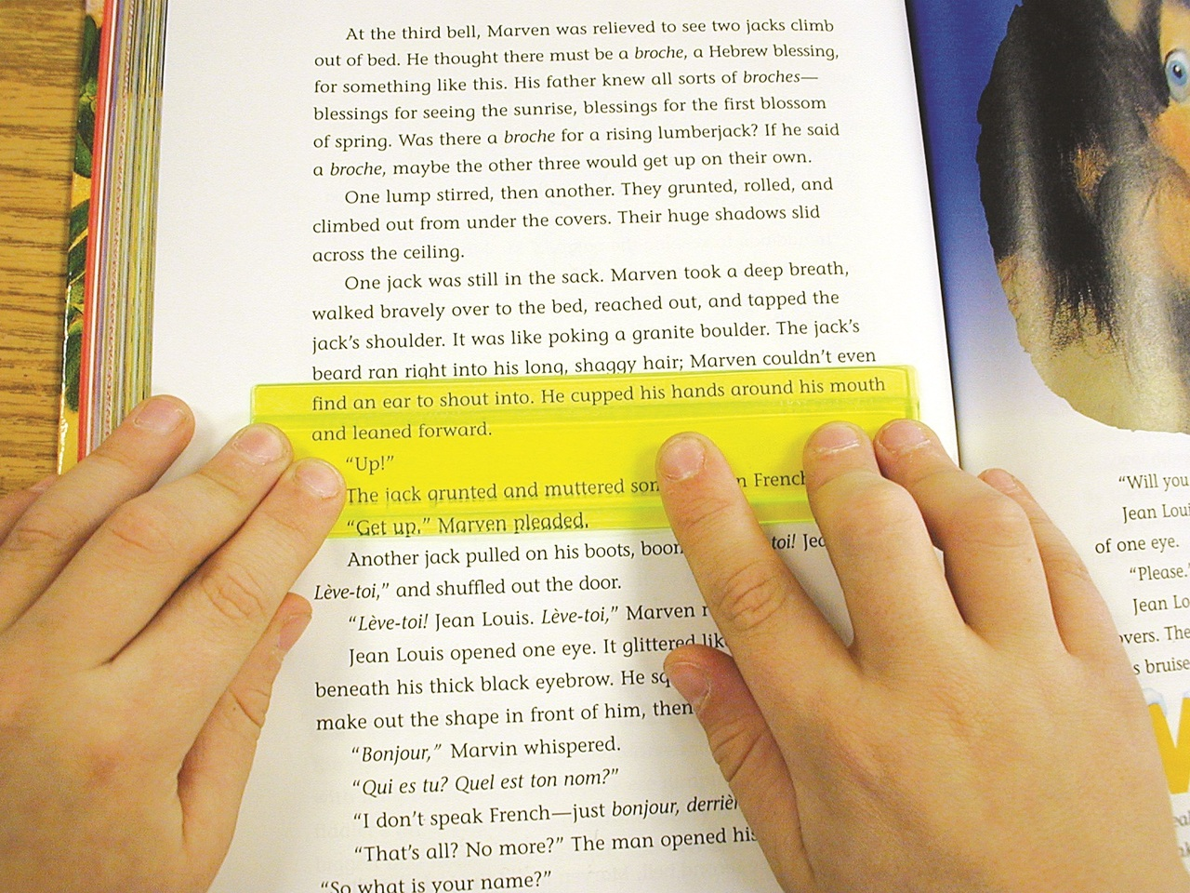
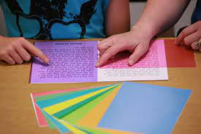
What does Immersive Reader do?
Text-to-Speech
Make text more accessible, by dynamically changing the way it appears on the screen.
Notes:
The Immersive Reader features fall into two categories.
Text-to-Speech
Making on-screen text more accessible
Let’s take a closer look.

Slide 4
Text-to-Speech
Click on the green “play” icon to have text read to you. First select single words or select passages if you don’t want everything on the page read.
Immersive Reader reads text whilst simultaneously highlighting the word being read.
Select the cog icon to change the voice or change the speed.
Notes:
Text-to-speech has come a long way since the robotic voices of yester-year. The natural speaking voices are really very good.
I’ve found it to be one of the most effective solution to the perennial issue getting students to proof their own writing.
Try it now whilst you’re using Microsoft PowerPoint!

Slide 5
Making On-screen Text Accessible
Click on the text tool to:
Change the text size
Increase the spacing between letters and words
Change the font. Sitika is particularly suitable for on-screen text
Change colour themes
Notes:
Changes are on-screen only. The saved document remains unchanged, and if you were to print it out it would be as originally intended.
When using Immersive Reader on a webpage it will remove all of the on-screen noise, including the ads.

Slide 6
Grammar Tools
Select the “Grammar Tools” to
Break words down into their individual syl‧la‧bles
Label or colour code the different types of words – nouns, verbs etc.
Notes:
These are very helpful tools to support students who are easily overwhelmed by text.

Slide 7
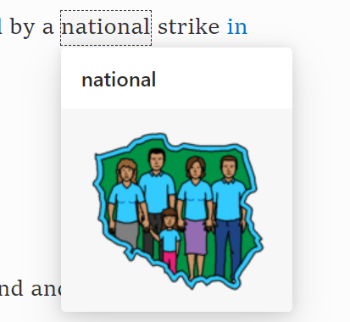
Reading Preferences
Select “Reading Preferences” to
Helps the reader to focus by highlight 1, 3 or 5 lines at a time.
Enable the “Picture Dictionary”. When your cursor turns into a star you can select a single word to see the relevant Boardmaker symbol alongside the option to have it read out to you.
Translation tools. Translate single words or entire documents into one of many different languages (including Bangla).
Notes:
There is specialist software available that will do much of what Immersive Reader does, but nothing that integrates so smoothly into mainstream software. And did I mention that it’s free?

Slide 8
Top-Tips
Immersive Reader works best when used with Office 365 running within the Edge browser.
Different voices are available for download. You may need help from your technician to install them. It requires administrator access.
It requires an internet connection to work, although there are work-arounds.
Not all features are available in all products.
I posted some video demonstrations on our blog previously, but the best way to learn is to have a go yourself. It’s very intuitive and accessible.
Office is free to educators and students.

