Slide 1
Using the LGFL Learning Resources
Tower Hamlets Language Literacy and Communication Team
January 2023

Slide 2
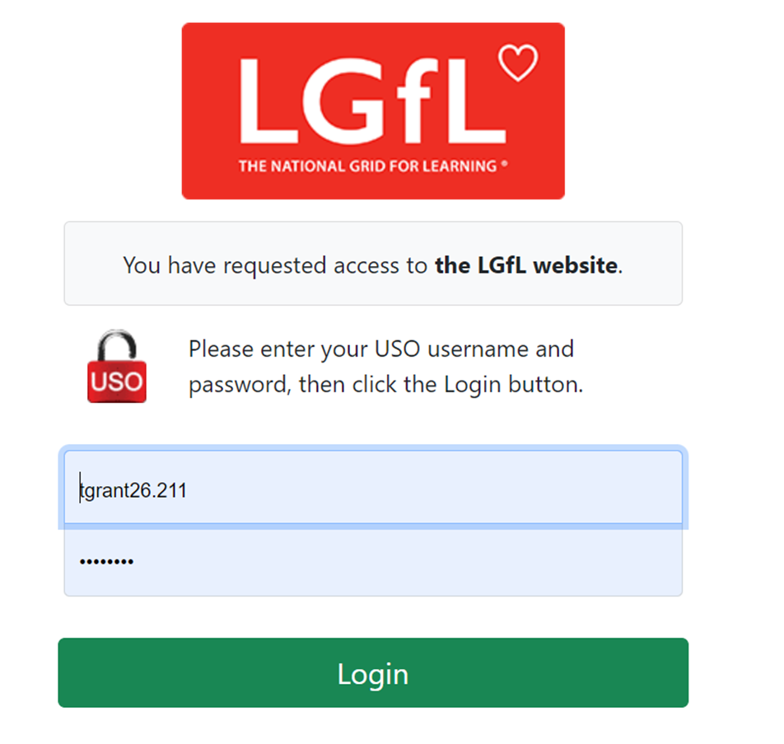
First Challenge….
You MAY be logged in already in a school. If not, you will need your LGfL user name and password.
If you don’t know it, ask your school computer lead or IT technician – they should be able to give it to you
All the pupils in your school should also have a log in so that they can also access some of the resources remotely and in school

Slide 3
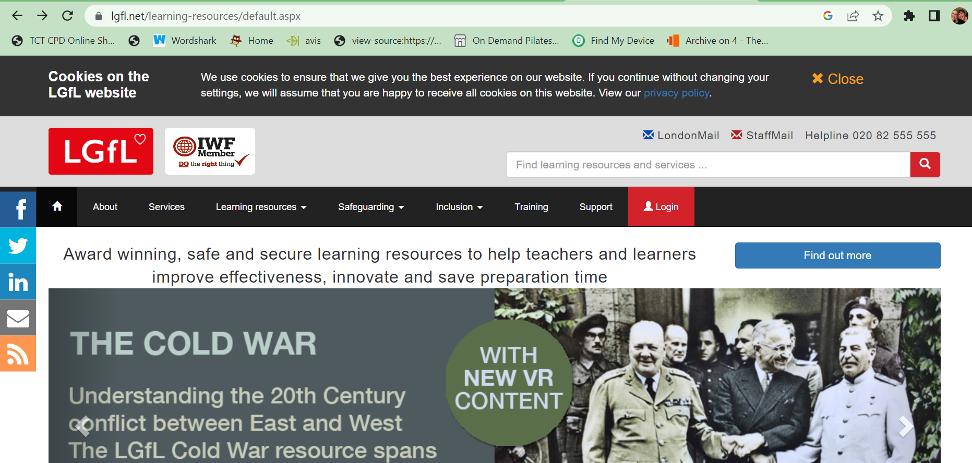
This is the link to the LGfL Learning Resources site: https://www.lgfl.net/learning-resources/default.aspx

Slide 4
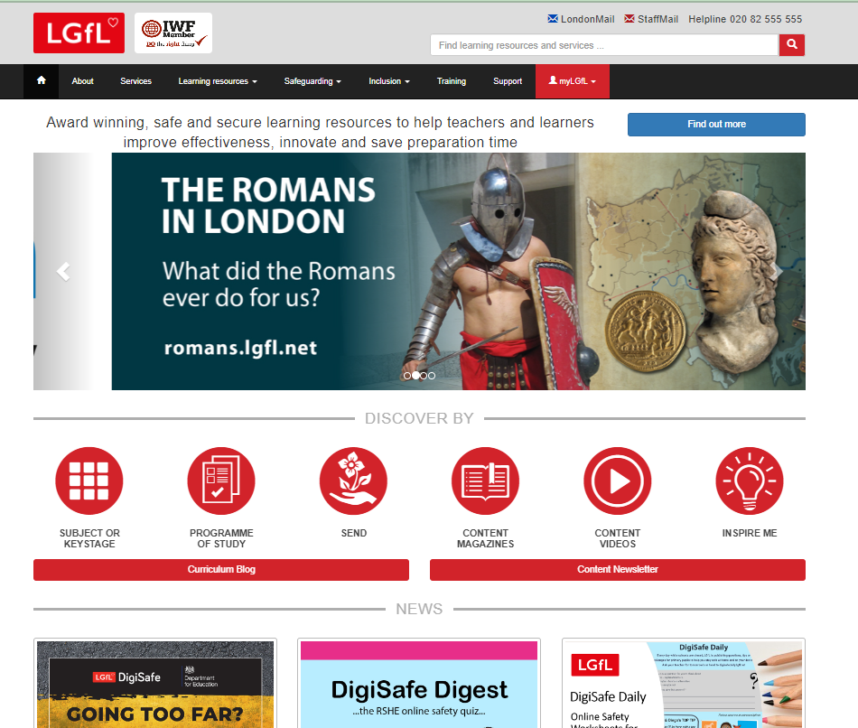
Link to SEND Resources….

Slide 5
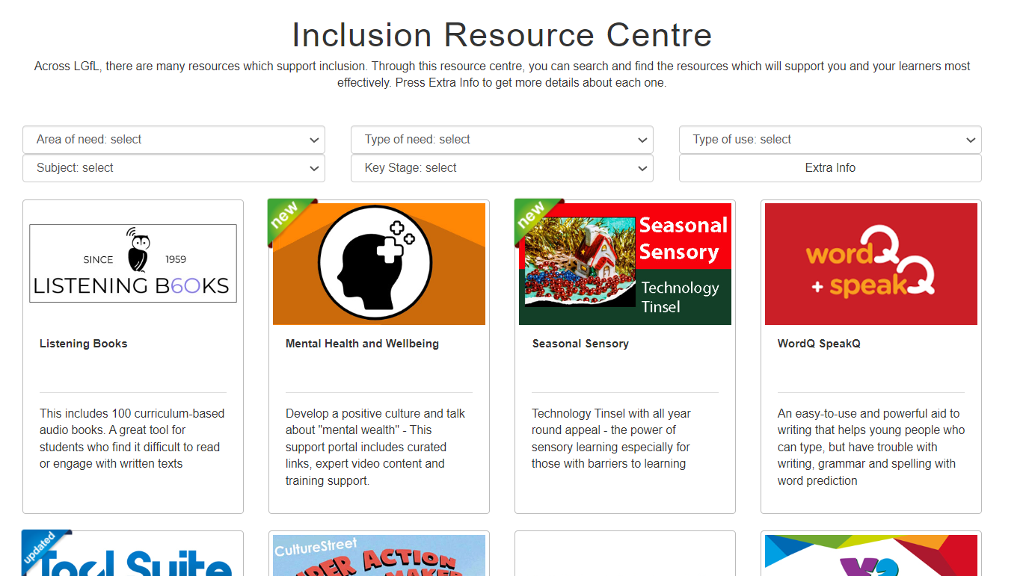
…lots of great resources to browse…..

Slide 6
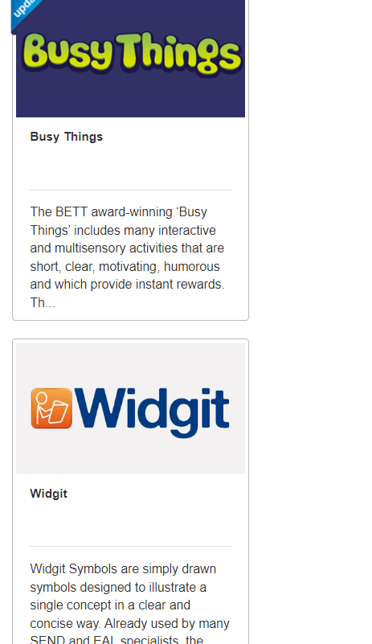
Two good ones to try out here….
Busy things is great for Primary schools
Widgit has lots of downloadable resources

Slide 7
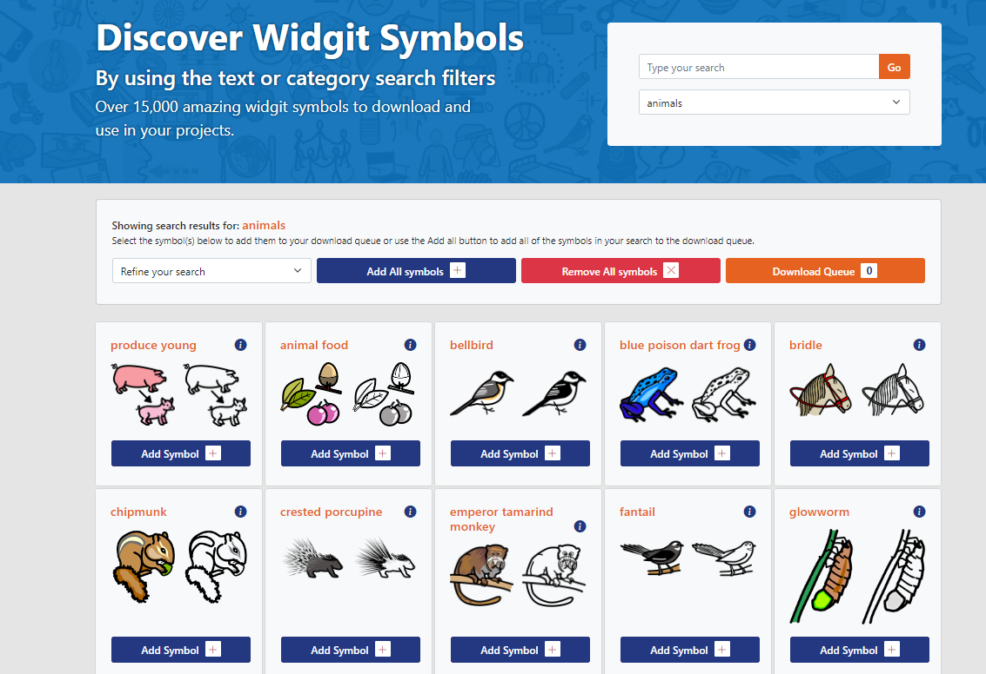
For example, you can search for symbols that you particularly need….

Slide 8
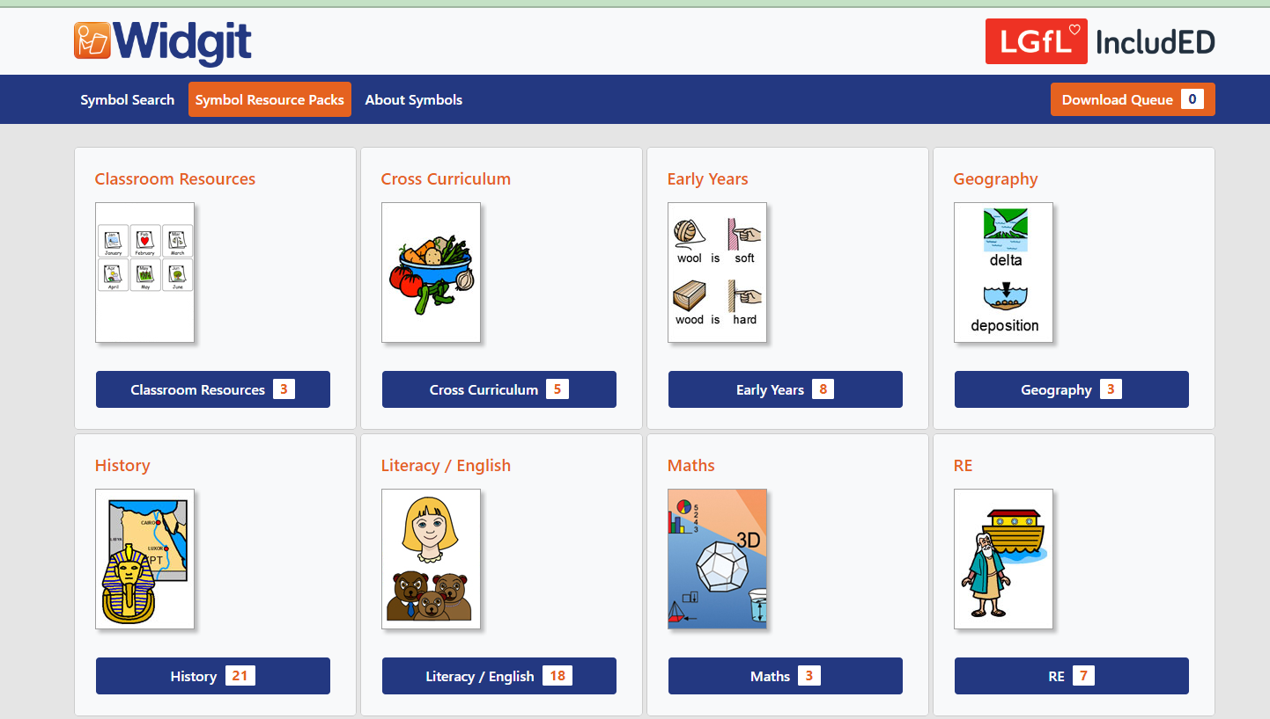
Or you can download ready made resources…

Slide 9
There really is something for everyone, and it is well worth spending a bit of time exploring your particular Key Stage, subject or area of SEND

