Slide 1
Supporting Communication in your classroom – Part 2 – sharing some more ideas from *
*A group of professionals supporting language and communication development
Tower Hamlets Language Literacy and Communication Team
May 2023

Slide 2
For general ideas to support language through the school Oracy Cambridge and Voice 21 are really good resources
Notes:
About us – ORACY CAMBRIDGE
Voice 21 | Oracy | United Kingdom

Slide 3
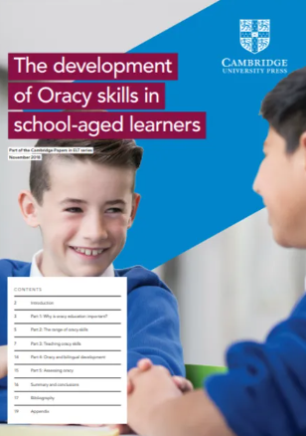
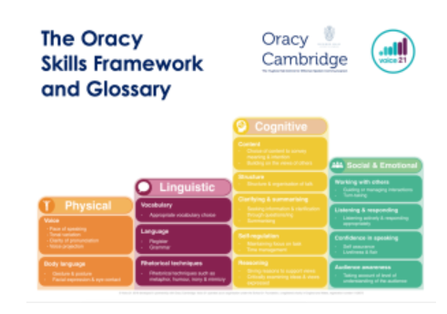
‘Oracy Cambridge’ aims to promote oracy generally.
Their website has a lot of free resources for supporting talk in the classroom and is well worth a look. Many local schools are using their framework.
Notes:
Resources – ORACY CAMBRIDGE

Slide 4
Voice 21 is a charity working to improve the UK’s oracy education for all young people
Notes:
Voice 21 | Oracy | United Kingdom

Slide 5
Improve discussions in Science lessons with this free resource: explorify.uk
Notes:
explorify.uk

Slide 6
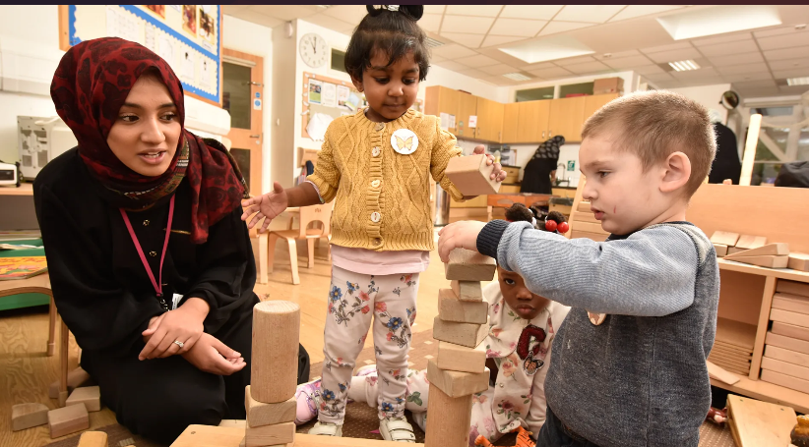
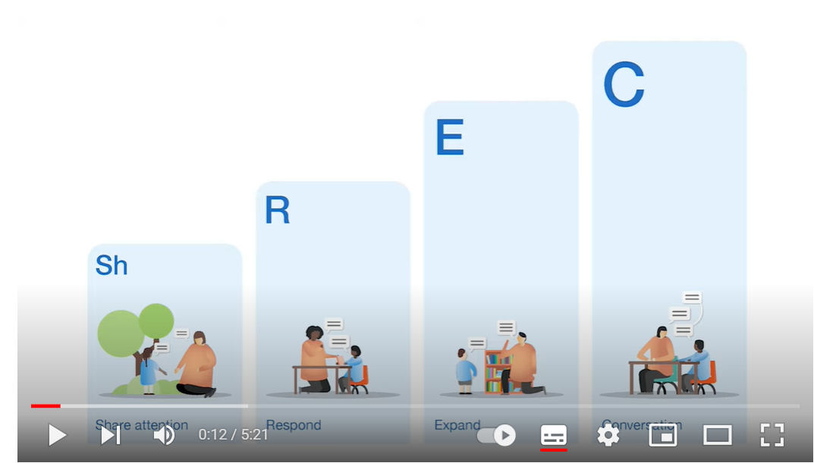
There are so many resources out there to try. Interested in learning more about high quality interactions in the Early Years? Have a look at:
The ShREC approach from the EEF
Video of the ShREC approach
Notes:
The ShREC approach:
Sh – Share attention
R- Respond
E – Expand
C – Conversation
The ShREC approach – Four evidence informed strategies to… | EEF (educationendowmentfoundation.org.uk)
High quality interactions in the Early Years - The ShREC approach – YouTube – 5 minutes long

Slide 7
Finally, there is so much useful information on this website for both parents and professionals:
Including
Progress checkers from 6 months to 11 years
Free CPD online short course
What Works database of evidenced interventions to support children’s speech, language and communication
A resource library for parents
Top tips for primary and secondary schools
Notes:
https://speechandlanguage.org.uk/ Speech and language uk has lots of advice and resources for both parents and professionals

