Slide 1
Supporting Communication in your classroom - PART 1 – sharing some ideas from *
*A group of professionals supporting language and communication development
Tower Hamlets Language Literacy and Communication Team
May 2023

Slide 2
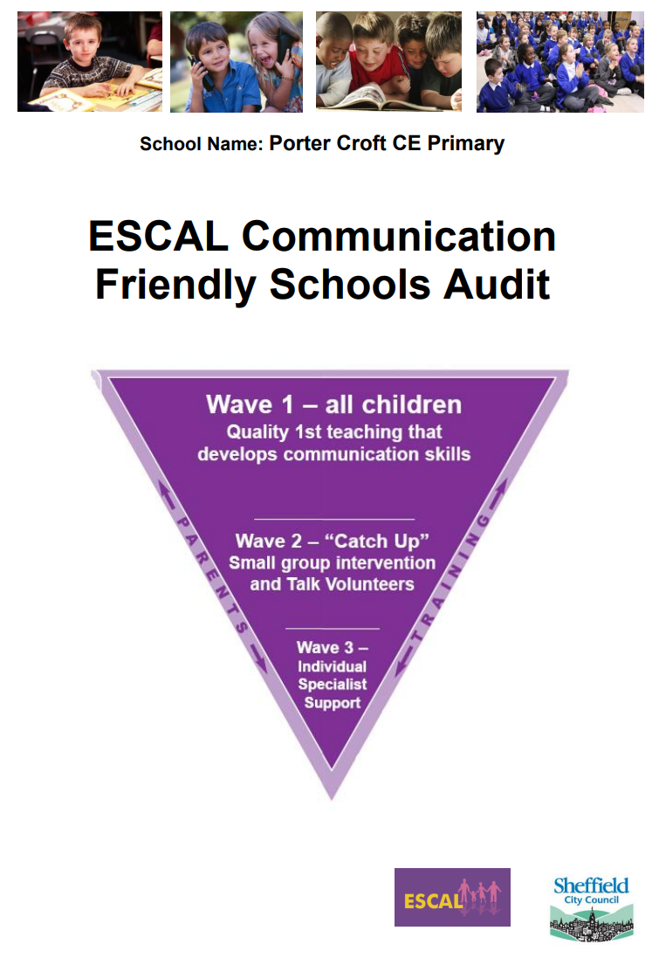
Here are some suggestions we recently came up with on making schools more ‘communication supportive’
This can be downloaded. It is aimed at Reception and KS1
First of all, consider working with a colleague and carrying out an audit of each other’s classroom – you may be doing more than you think
There are lots of good audits and checklists available online. For example:

Slide 3
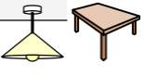
The Environment
Noise Levels:
What is the general level of noise like?
Are there noisy distractions from inside or out?
Are there ways to gain people’s attention?
Can everyone hear and be heard? Are there times of quietness?
Space Light and Layout:
Are there cosy, comfortable places to talk?
Can you see people’s faces when they are talking?
Can you rearrange the layout of the room to suit different opportunities for talking – as pairs, or in small or large groups?
Using Visual Support:
How widely and consistently are signs, symbols, photos and writing used?
Are they used as labels, to support routines, or as timetables?
Are parents shown how they work?
Is there the right amount?
Are they age appropriate?
Clear and Consistent Routines:
How does the classroom environment help children to know what to expect and when?
How well are visual supports used to help children understand and follow routines?

Slide 4
Do all adults prioritise communication by:
Knowing about language development?
Understanding the language levels of the children?
Being aware of language demands in the classroom?
Adapting their language so it isn’t a barrier to learning?
Helping children to say when they don’t understand?

Slide 5
Facilitating peer to peer interaction – some ideas to try…..
Mixed ability groups
‘Cue jar’ to generate open-ended conversations – slips of sentence starters in a jar
Teach the rules of conversation
Provide visual cards to support children to get started and take turns
Notes:
About us – ORACY CAMBRIDGE
Voice 21 | Oracy | United Kingdom

Slide 6
……..Part 2 of Supporting Communication will have more resources to use in your classroom – watch this space!
Tower Hamlets Language Literacy and Communication Team

