Slide 1
Supporting Communication at home
Tower Hamlets Language, Literacy and Communication Team
July 2023

Slide 2
Learning new words
There will be lots of opportunities for your child to learn new words at home with you
Remember learning words is best linked to real experiences
Repetition is really important for words to become part of their vocabulary
Have fun learning new words, for example, sparkle, spin. bounce, whisper
Teaching children new words (speechandlanguage.org.uk)
Notes:
About us – ORACY CAMBRIDGE
Voice 21 | Oracy | United Kingdom

Slide 3
Games are fun and help with learning
top-10-toys-factsheet.pdf (speechandlanguage.org.uk)
Dr Claire Halsey's top tips for 3-4 years: Memory game - BBC Tiny Happy People
Games teach us valuable social skills such as waiting, taking turns and that sometimes you may win and sometimes you may not

Slide 4
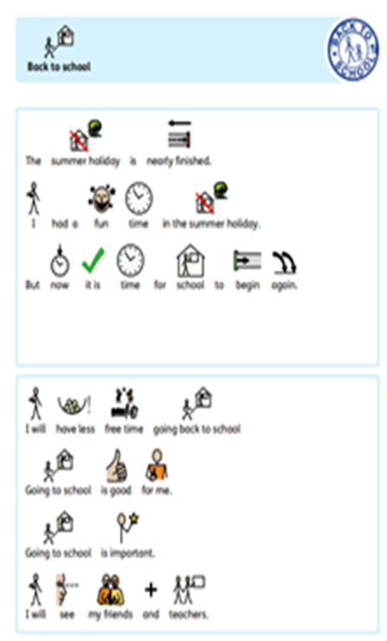
Getting ready for September
Social stories can help your child prepare for September
The link below will provide you with lots of resources to get you and your child ready
https://towerhamletslas.edublogs.org/files/2023/07/back-to-school-1-1.pdf
Try to start the school routine around two weeks before school starts with earlier bedtimes, getting up in the mornings and eating lunch at school time

Slide 5
Finally, there is so much useful information on this website for both parents and professionals:
They used to be called ICAN and you will find
Progress checkers from 6 months to 11 years
A resource library for parents
Top tips for primary and secondary schools
Another useful website is Talking Point www.talkingpoint.org.uk
Notes:
https://speechandlanguage.org.uk/ Speech and language uk has lots of advice and resources for both parents and professionals

