Slide 1
Assistive Technology to support struggling writers in KS2/3
Advisory Teachers for Language, Literacy & Communication
Tower Hamlets Learning Advisory Service
Notes:
Welcome to this session on Assistive Technology to support struggling writers which we are running as part of Dyslexia Awareness Week This 5-minute powerpoint will identify and explain some of the difficulties struggling learners face in the classroom. It will also present a selection of key assistive technology to support teaching and learning to help overcome these barriers.

Slide 2
Education vs “real-life”
The sort of day-to-day writing that we do is often quite different to the sort of writing that our learners do.
Notes:
Often ours is either very informal (texts, shopping lists, notes to others, etc.) or very formal, such as reports, etc. We also tend to use a wider range of tools for writing: keyboards, smartphones, etc.
Our learners on the other hand tend to have to write in a wider variety of more formal contexts that are governed by specific conventions such as stories, science experiment reports, recounts and so on. This sort of writing is certainly more complex than day-to-day writing for a specific purpose. They may also do a lot more handwriting.

Slide 3
Skills for writing list
Motor skills. The physical ability to form the letters and words and make legible marks on paper. Even where a keyboard is used there is still a degree of motor skill required in order to be able to operate the keyboard effectively.
Knowledge of language. This includes vocabulary, spelling, grammar, syntax, punctuation etc. In other words, the tools to follow written conventions so that others can understand the sense of what is written.
Ability to organise and structure ideas. Depending on what is being written, following a particular structure will assist the reader with
Confidence in our ability to write. Whilst not necessarily a skill, an individual must have sufficient confidence in order to put pen to paper and then allow others to read what they have written.
Notes:
These are just some of the very basic skills that are required for writing, with each one of these being underpinned by a raft of sub-skills and complexities. Writing is therefore a highly complex task that requires the individual to be able to orchestrate a whole range of skills simultaneously, efficiently and quickly. If just one of these areas causes difficulty then writing will become very challenging.

Slide 4
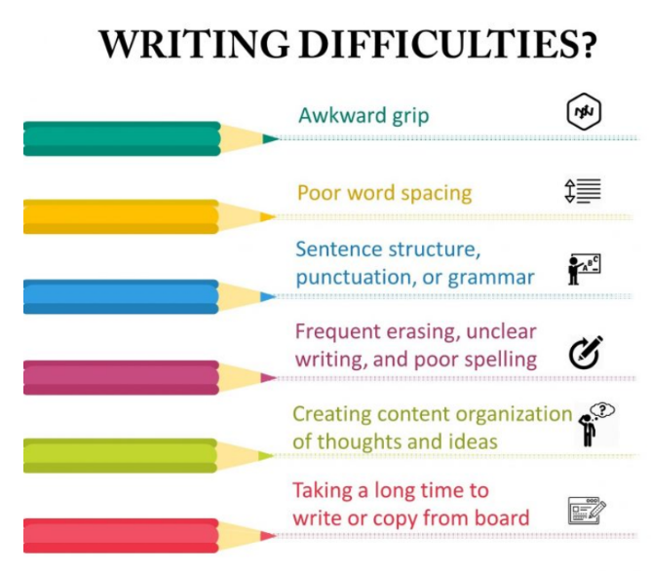
Notes:
Children who struggle with writing will often present with these difficulties. Physical difficulties with forming the letters may lead to poor handwriting, particularly if the individual also has dyspraxic-type issues. Where an individual is not automatic with matching letter sounds to letter symbols (known as phoneme/grapheme correspondence) or is not automatic with reproducing correct spellings, their writing will suffer. Problems with spelling may mean that the individual either can’t write what they want to because they don’t know how to spell the words, or instead constantly has to adjust what they want to write in order to only include words that they can spell. So much of the brain’s processing capacity is taken up with these basic issues that there is little space or energy left to think about what to write.

Slide 5
Writing difficulties linked to the cognitive deficits associated with dyslexia
Characteristic feature | Writing difficulty
Phonological awareness | Not automatic with matching letter sounds to letter symbols or is not automatic with reproducing correct spellings only includes words that they can spell little energy left to think about what to write.
Verbal memory | Problems with short term and working memory Ideas are forgotten or they can’t be retrieved from the working memory quickly enough to use
Verbal processing speed | Problems with vocabulary- underdeveloped May or may not really reflect the individual’s intellect or understanding Handwriting is slow
Organisation | Writing is difficult for the reader to follow or repeated
Self-esteem | Quickly lose confidence Disengagement with writing process
Children struggling in these areas will find it difficult to learn and progress.

Slide 6
Instructional Theory
Notes:
Haring and Eaton’s Theory of Instructional process
Skills are taught but not taken to fluency (can’t keep it in the memory to practice). There will be difficulty maintaining skills in the long-term memory. Children with these difficulties will not be able to express themselves of develop literacy skills necessary educational success and life.

Slide 7
What is Assistive Technology?
Speech recognition / Text-to-speech (and computer voices)
Spell checkers and grammar checkers
Word prediction / scaffolding software
Graphic facilitation (organisers and mind mapping)
Touch typing (an oldy, but a goody).

Slide 8
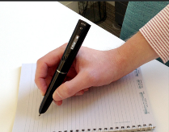
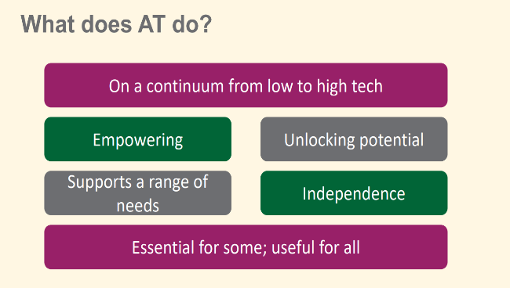
Benefits of Assistive Technology
for Writers

Slide 9
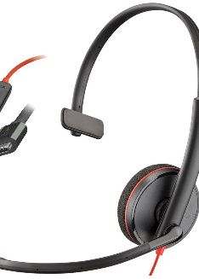
Bundled Speech Recognition
Bundled speech recognition software
Increasingly accurate, needing less training and specialist knowledge to use.
Generally, requires a good internet connection to work effectively.
To work in a classroom environment with external noises it’s worth investing in a good quality microphone with an omni-directional microphone and/or noise cancelling.
I’d usually suggest using bundled tools before investing in expensive speech-recognition software.
Notes:
When is speech-to-text not appropriate?
NOT A MAGIC BULLET
When a student can’t express themselves in full, grammatically correct and formal sentences.
When a student's speech lacks breath support.
When a student's pronunciation is inconsistent.
When a student lacks motivation or focus.

Slide 10
Specialist Speech Recognition
When would I consider it?
What software would I need?
Many of the tools we have looked at do the work of voice recognition in the cloud, requiring a reliable internet connection.
Any software that works "locally" requires a reasonably powerful device and extensive training to work effectively.
Notes:
Where we have a student, who for whatever reason, is struggling with their handwriting.
Once the concept of voice-to-text as a means of accessing writing has been proven.
Sometimes we will need to consider bespoke speech-to-text to comply with QCA regulations for exams. The guidance is changing rapidly.
Where bundled speech recognition doesn’t work for a student due to a speech impediment. Some impediments are very hard for the software to overcome, for example, stutters.

Slide 11
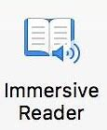
TTS Text-to-Speech
Text-to-speech
Powerful tool for proof-reading work.
The voices have become more natural and customizable over recent years.
In-built into Office 365 – access via Immersive Reader, or the "Read Aloud"
There are TTS tools now built into all the major operating systems and word processors.
Notes:
What does TTS stand for?
A text reader can help with writing. You can:
Proof-read your own writing
Spot misspelt words
Read you text back to improve sentence structure, sense and meaning.
Demonstrate "Read Aloud" in Office 365. Notice the AI voice.

Slide 12
Other tools for TTS
Natural Reader (Chrome Extension, Android, iOS). Fremium.
Helperbird (Chrome Extension). Fremium.
Read&Write (standalone PC, Chrome Add-on). Free for teachers.
Notes:
The tools are getting more and more effective. The voices are getting better and more intelligent. Tools like Natural Reader are effectively free, and will read anything that you through at it – in the real world or on-screen.
Helperbird is a Chrome extension that brings Immersive Reader any browser that can run Chrome extensions.
Download Natural Reader now! Register! Give it a go!

Slide 13
Specialist Word Prediction Software
Bundled into many literacy support software
Usually have flexible/phonetic spellings
Some have homophone/confusable word support
Can be used within different applications.
Notes:
Sometimes we need specialist word prediction software.
A good example is Read&Write (Paid for, but very reasonable. Free for teachers. £2 per student for schools.)
Also WordQ. Free for LGFL schools (unfortunately, only the older WQ4 is avaliable for free)
Demonstrate Word Prediction software. Demonstrate dictionaries, "read-out-loud", dictionaries/lexicon, symbol support in prediction menu, homophone/confusable word support.

Slide 14
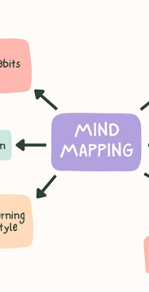
Mind Mapping
Mind-mapping has been around for a long time.
Digital Mind Maps have advantages over using pen and paper.
Some will need to be downloaded and installed (speak to your IT person), and others are online
Examples include:
Clicker Boards (for younger students)
Kidspiration / Inspiration 10.
Ayoa (the future)
Notes:
So, mind mapping has been around for a long time. But why would we choose to do it digitally rather than on paper?
We can work collaboratively.
We can include media.
It can be easily manipulated and changed.
It can be quickly exported into other formats, such as into doucuments.
Clicker 8 boards
Ayoa

Slide 15
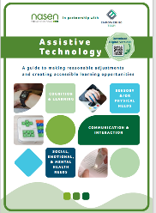
Resources and Publications
Assistive Technology in the Classroom: Enhancing the School Experiences of Students with Disabilities (2nd Edition) 2nd Edition
by Amy G. Dell (Author), Deborah A. Newton (Author), Jerry G. Petroff (Author)
British Dyslexia Association (bdadyslexia.org.uk) https://nasen.org.uk/ https://www.understood.org/en/articles/free-assistive-technology-tools-on-the-web https://www.wholeschoolsend.org.uk/assistive-technology Call Scotland https://www.callscotland.org.uk/ AbilityNet https://abilitynet.org.uk/
This miniguide, developed by Empowering Tech in conjunction with nasen, is for SENCOS, school leaders, teachers and support staff.
This guide aims to:
Provide an understanding of what Assistive Technology (AT) is
Explore solutions to the challenge of learner diversity using practical examples of AT
Help you develop strategies to achieve the successful implementation of AT
https://nasen.org.uk/atminiguide

